Slide 1
LOAN DEFAULT RISK PREDICTION
-NITHIKKSHA

Slide 2

PROBLEM STATEMENT
Developing a machine learning model to accurately predict loan default risk, aiding lending institutions in informed decision-making and risk management strategies.

Slide 3
FLOW CHART
DATA COLLECTION
DATA PREPROCESSING
BASE MODEL
CLASS IMBALANCE TREATMENT
EDA-OUTLIERS, SKEWNESS TREATMENT
MODEL BUILDING
SECOND DATAFRAME
FEATURE SELECTION
FINAL DATAFRAME

Slide 4
DATASET INSIGHTS
DATA SHAPE
This dataset has 100000 rows and 13 columns
TARGET COLUMN
This target variable of this data is Loan default risk which has the values one and zero.
The target variable is categorical.
There are 12 independent columns like applicant income, applicant age, house ownership that impacts the target variable.

Slide 5
DATA PREPROCESSING
NULL VALUE TREATMENT
DATATYPE CONVERSION

Slide 6
BASE MODEL
MODEL NAME | ACCURACY | TPR | FPR | SPECIFICITY | PRECISION | RECALL
LOGISTIC | 87.080 | 1.000 | 1.000 | 0.000 | 0.870 | 0.930
DECISION TREE | 93.300 | 0.949 | 0.176 | 0.823 | 0.973 | 0.960
RANDOM FOREST | 93.345 | 0.946 | 0.146 | 0.853 | 0.977 | 0.960
KNN | 92.955 | 0.949 | 0.202 | 0.797 | 0.969 | 0.958
NAÏVE BAYES | 87.080 | 1.000 | 1.000 | 0.000 | 0.870 | 0.930
SVM | 87.080 | 1.000 | 1.000 | 0.000 | 0.870 | 0.931
XG BOOST | 91.375 | 0.974 | 0.495 | 0.504 | 0.929 | 0.950
ADABOOST | 93.295 | 0.949 | 0.176 | 0.823 | 0.973 | 0.960

Slide 7
BASE MODEL CONCLUSION
The Random forest model performs the best with an accuracy of 93.34%
Based on the F1 score, Random forest is the best model with a score of 0.960 indicating a good balance between precision and recall.

Slide 8
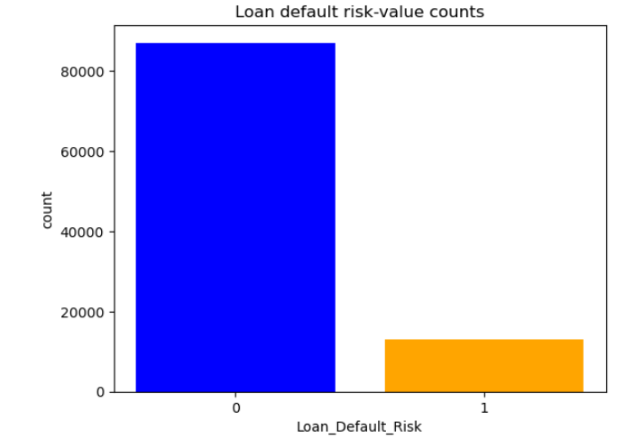
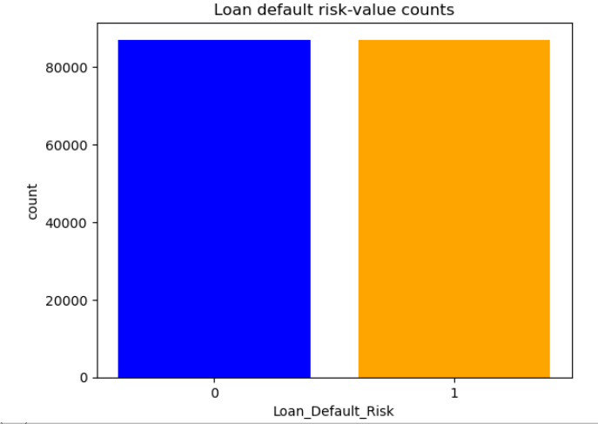
CLASS IMBALANCE
BEFORE CLASS
IMBALANACE
TREATMENT
AFTER CLASS
IMBALANCE
TREATMENT

Slide 9
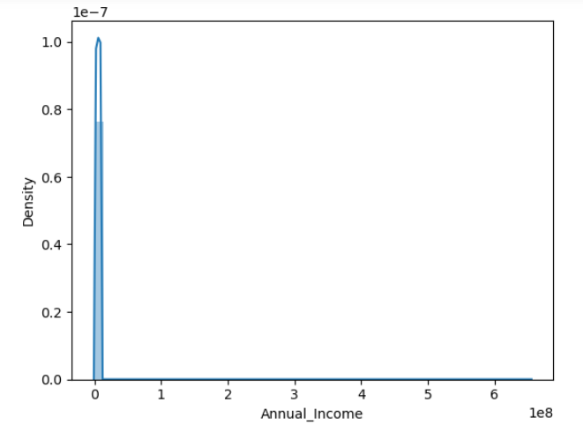
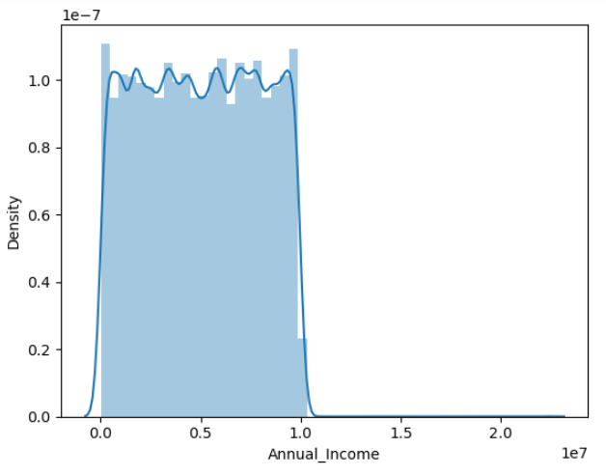
OUTLIER TREATMENT
WITH OUTLIERS
AFTER TREATING OUTLIERS

Slide 10
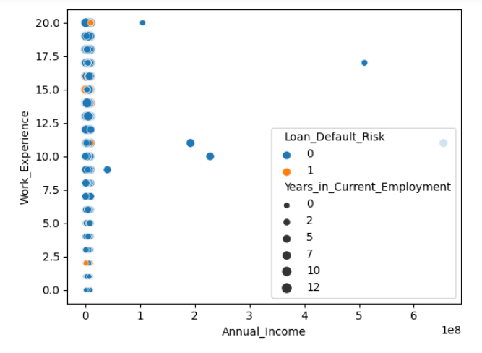
VISUALIZATION

Slide 11
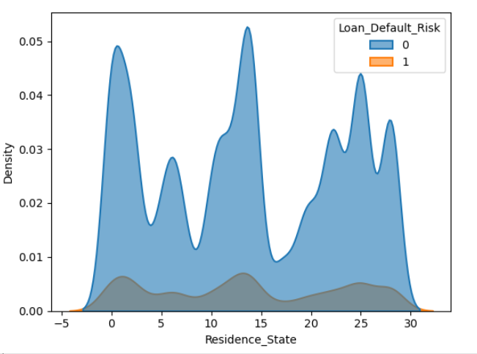
VISUALIZATION

Slide 12
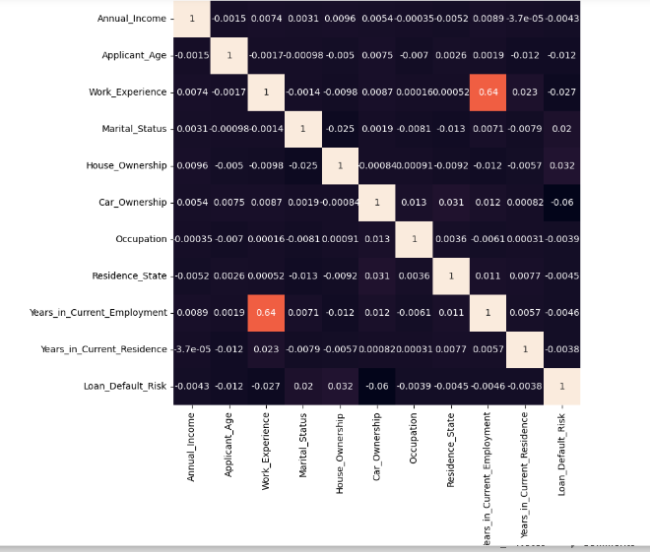
VISUALIZATION

Slide 13
SECOND DATAFRAME
MODEL NAME | ACCURACY | TPR | FPR | SPECIFICITY | PRECISION | F1-SCORE
LOGISTIC | 50.172 | 1.000 | 1.000 | 0.000 | 0.500 | 0.666
DECISION TREE | 96.023 | 0.921 | 0.001 | 0.998 | 0.998 | 0.957
RANDOM FOREST | 96.014 | 0.921 | 0.001 | 0.998 | 0.998 | 0.957
KNN | 95.755 | 0.923 | 0.010 | 0.989 | 0.989 | 0.954
NAIVE BAYES | 50.916 | 0.520 | 0.482 | 0.517 | 0.520 | 0.519
SVM | 51.474 | 0.699 | 0.683 | 0.316 | 0.492 | 0.572
XG BOOST | 94.488 | 0.912 | 0.015 | 0.984 | 0.983 | 0.945
ADABOOST | 96.023 | 0.921 | 0.001 | 0.998 | 0.998 | 0.957

Slide 14
DATAFRAME CONCLUSION
The Adaboost model performs the best with an accuracy of 96.02%
Based on the F1 score, Adaboost is the best model with a score of 0.957 indicating a good balance between precision and recall.
FEATURE SELECTION
CHI SQUARE

Slide 15
MODEL-DATAFRAME
MODEL NAME | ACCURACY | TPR | FPR | SPECIFICITY | PRECISION | F1-SCORE
LOGISTIC | 50.172 | 1.000 | 1.000 | 0.000 | 0.500 | 0.666
DECISION TREE | 96.023 | 0.921 | 0.001 | 0.998 | 0.998 | 0.957
RANDOM FOREST | 96.014 | 0.921 | 0.001 | 0.998 | 0.998 | 0.957
KNN | 95.755 | 0.923 | 0.010 | 0.989 | 0.989 | 0.954
NAIVE BAYES | 50.916 | 0.520 | 0.482 | 0.517 | 0.520 | 0.519
SVM | 51.474 | 0.699 | 0.683 | 0.316 | 0.492 | 0.572
XG BOOST | 94.488 | 0.912 | 0.015 | 0.984 | 0.983 | 0.945
ADABOOST | 96.023 | 0.921 | 0.001 | 0.998 | 0.998 | 0.957
FEATURE SELECTION | 96.011 | 0.921 | 0.001 | 0.998 | 0.998 | 0.943

Slide 16
CONCLUSION
The Adaboost model performs the best with an accuracy of 96.02%.
Based on the F1 score, Adaboost is the best model with a score of 0.957 indicating a good balance between precision and recall.

Slide 17
MERITS
This model uses machine learning for precise risk assessment, cost reduction, and regularity compliance
Benefits include proactive risk management, lower non-performing loan costs and improved decision making
Enhance portfolio performance and customer satisfaction with this advanced risk prediction tool

Slide 18
DEMERITS
The data has a huge class imbalance which leads to biased model and potential misclassification of minority class instance, when it is not treated.

Slide 19
THANK YOU

